Slide 1


THE
BIKE STORE

Slide 2
PROJECT OBJECTIVE:
"Bike Store Retail Analytics for Optimized Sales and Inventory Management"
The objective is to build a comprehensive SQL-based data analytics system for a multi-store retail business. The system will analyze sales performance, customer behavior, inventory levels, and operational efficiency. Insights from this system will aid in optimizing stock management, improving customer engagement, and identifying revenue-generating strategies.

Slide 3
PROBLEM STATEMENT:
A retail chain with multiple stores, staff, and a wide range of products struggles with several operational challenges:
Customer Insights:
Identifying frequent buyers and understanding customer purchasing patterns.
Segmenting customers into tiers to target promotions effectively.
Sales Optimization:
Tracking sales trends by products, categories, and stores.
Recognizing top-performing stores and identifying areas of improvement.
Inventory Management:
Identifying products with low stock levels.
Ranking products based on sales to prioritize restocking efficiently.
Operational Efficiency:
Understanding delays in shipping and identifying causes.
Evaluating monthly sales and predicting future trends.

Slide 4
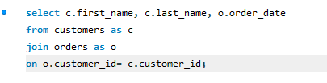
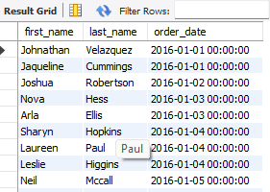
RETRIEVE ALL ORDERS PLACED BY CUSTOMERS, INCLUDING ORDER DATE AND CUSTOMER NAME.
4

Slide 5

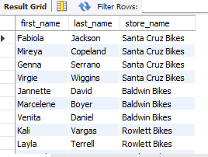
2. LIST ALL STAFF MEMBERS AND THE STORES THEY ARE ASSOCIATED WITH.

Slide 6

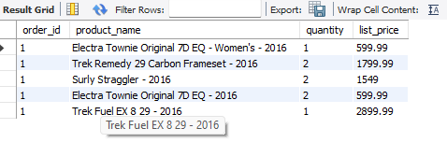
3. RETRIEVE THE DETAILS OF ALL ITEMS PURCHASED IN A PARTICULAR ORDER.

Slide 7
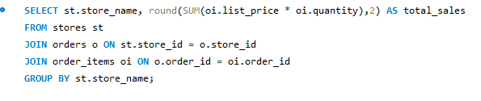
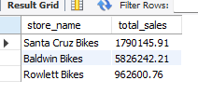
4. CALCULATE THE TOTAL SALES MADE BY EACH STORE.

Slide 8
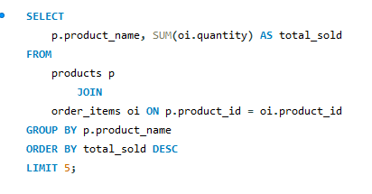
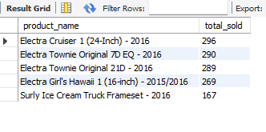
5. IDENTIFY THE TOP 5 BEST-SELLING PRODUCTS BASED ON QUANTITY SOLD.

Slide 9
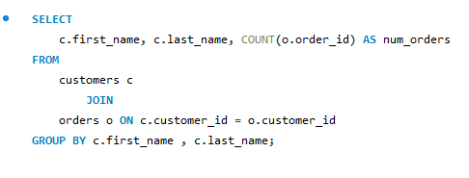
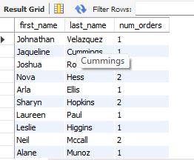
6. FIND THE NUMBER OF ORDERS EACH CUSTOMER HAS PLACED.

Slide 10
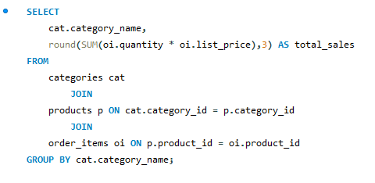
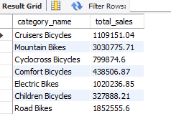
7. CALCULATE THE TOTAL SALES PER PRODUCT CATEGORY.

Slide 11
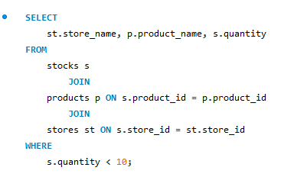
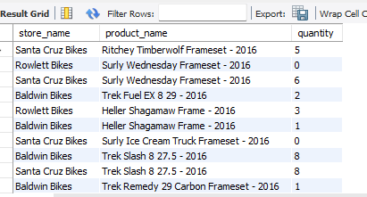
8. LIST ALL PRODUCTS THAT HAVE LESS THAN 10 UNITS IN STOCK IN EACH STORE.

Slide 12
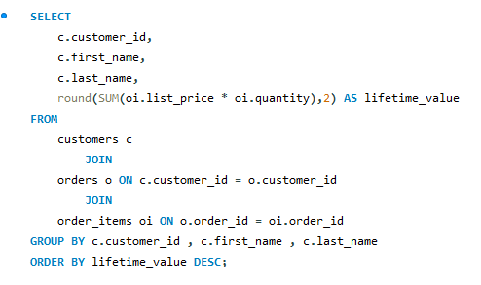
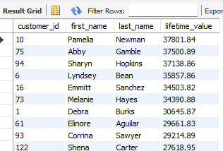
9. CALCULATE THE TOTAL VALUE OF ORDERS PLACED BY EACH CUSTOMER, CONSIDERING ALL THEIR ORDERS.

Slide 13
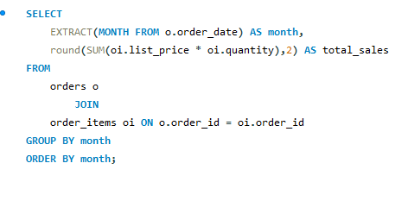
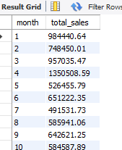
10. CALCULATE THE TOTAL SALES FOR EACH MONTH.

Slide 14
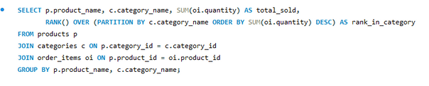
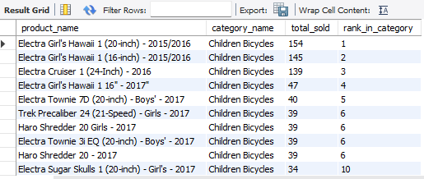
11. RANK PRODUCTS WITHIN EACH CATEGORY BASED ON THE TOTAL QUANTITY SOLD USING WINDOW FUNCTIONS.

Slide 15
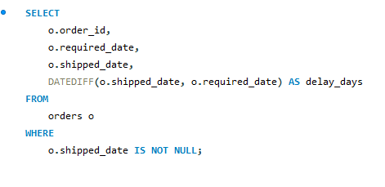
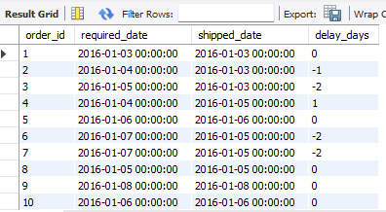
12. CALCULATE THE AVERAGE DELAY BETWEEN THE REQUIRED_DATE AND THE SHIPPED_DATE OF EACH ORDER.

Slide 16
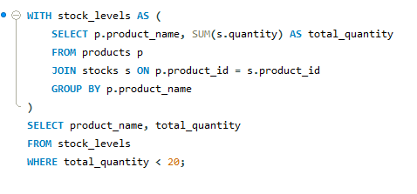
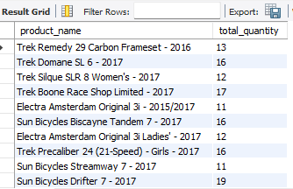
13. IDENTIFY PRODUCTS THAT NEED RESTOCKING (LESS THAN 20 UNITS IN STOCK ACROSS ALL STORES).

Slide 17
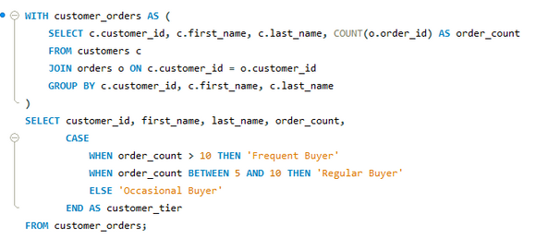
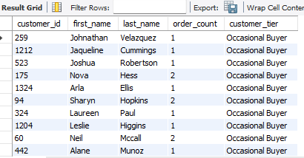
14. CALCULATE THE FREQUENCY AT WHICH CUSTOMERS MAKE PURCHASES, AND ASSIGN THEM INTO TIERS (E.G., "FREQUENT BUYERS", "OCCASIONAL BUYERS").

Slide 18
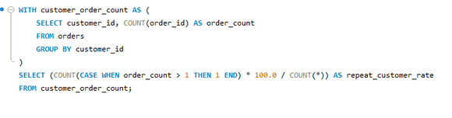
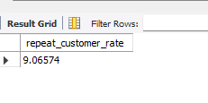
15. CALCULATE THE PERCENTAGE OF CUSTOMERS WHO HAVE MADE MORE THAN ONE ORDER.

Slide 19
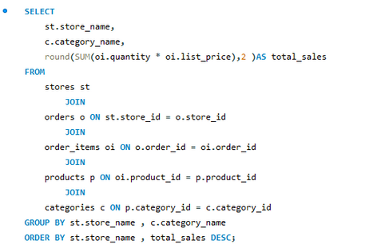
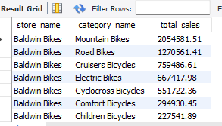
16. FOR EACH STORE, FIND THE TOP-SELLING PRODUCT CATEGORIES BY TOTAL SALES.

Slide 20
CONCLUSION
CUSTOMER INSIGHTS :
INSIGHT: ONLY 9% OF CUSTOMERS ARE REPEAT BUYERS, INDICATING POTENTIAL FOR IMPROVING CUSTOMER RETENTION STRATEGIES.
INSIGHT: MOST CUSTOMERS FALL INTO THE "OCCASIONAL BUYERS" CATEGORY, HIGHLIGHTING AN OPPORTUNITY TO ENCOURAGE MORE FREQUENT PURCHASES.
SALES OPTIMIZATION:
‘ BALDWIN BIKES STORE’, IS PERFORMING THE BEST, LIKELY DUE TO HIGHER CUSTOMER TRAFFIC OR BETTER MARKETING STRATEGIES.
'ROWLETT BIKES STORE', UNDERPERFORMS, WHICH MIGHT REQUIRE A REVIEW OF ITS PRODUCT OFFERINGS, LOCATION, OR STAFF EFFICIENCY
INVENTORY MANAGEMENT:
CERTAIN PRODUCTS HAVE A TOTAL QUANTITY OF LESS THAN 20 ACROSS ALL STORES, WHICH HIGHLIGHTS THE NEED FOR URGENT RESTOCKING. FOR EXAMPLE, PRODUCTS LIKE "TREK REMEDY 29 CARBON FRAMESET - 2016" AND "ELECTRA AMSTERDAM ORIGINAL 3I - 2015/2017" ARE RUNNING LOW ACROSS ALL LOCATIONS.
OPERATIONAL EFFICIENCY:
MONTH 4 (APRIL) EXHIBITS THE HIGHEST TOTAL SALES WITH 1,350,058.59.
MONTH 1 (JANUARY) HAS STRONG SALES AT 984,440.64, INDICATING A POSSIBLE POST-HOLIDAY SHOPPING SURGE.
MONTH 10 (OCTOBER) SHOWS A DIP WITH TOTAL SALES AT 584,587.90, WHICH MAY SUGGEST REDUCED CONSUMER ACTIVITY DURING THIS TIME.

